Slide 1
Rash Driving Detection System
By
Atharva Kango(44)
Nikita Aware(107)
Sagar Mhantati(31)

Slide 2
Problem Statement :
Transportation by road is one of the major factors that have been affecting the commercial development of our country. With the increasing vehicular population and their movement on the roads, accidents are also steadily increasing. It has become a nightmare for the authorities to prevent or reduce such fatal accidents on the road and all their efforts are in vain.

Slide 3
Project Concept:
There is exponential Increase in deaths due to road accidents.
Total deaths due to road accidents In India is 1.1Lakh/year.
Out of these, most of them are due to rash driving
Hence, solving this problem by using smart device.

Slide 4
Present Market Situation:
Lack of devices.
Present devices are costly.
Present devices are not usable for heavy vehicles like truck etc.

Slide 5
Project Objectives :
To Make a Fully Functional System, capable of detecting whether a driver is rash or not.
To help the owners of the vehicles & the government as well and make them, aware of such bad drivers.

Slide 6
Modules to be implemented :
1. Configuration of Raspberry Pi and sending data to the server
2. Processing the data on the server, and
3. Visualization on an Android App ( Whether the driver is Rash Driver or not )

Slide 7
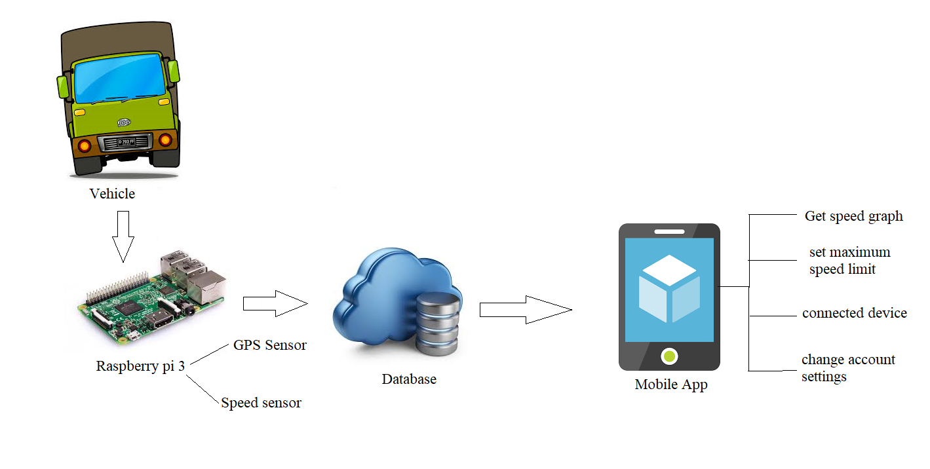
Project Idea:

Slide 8
Implementation :
The Speed Sensor is for measuring the speed and GPS sensor for tracing the location . By this data comparing the speed of the vehicle with threshold speed.
If speed is greater than the placed threshold speed then taking the location of the vehicle and checking that , is that speed appropriate for that road ?
If not, and this behaviour continues for the driver, then plotting a graph with the collected data
Showing the data on the Android app to the Owner or the superior Authority.

Slide 9
Technologies To Be Used :
IOT ( Use of Raspberry Pi for data collection and sending to server)
Data Analysis and Visualization ( Using Python, Particularly Jupyter Notebook and Matplotlib )
Visualization of graphs and the data on Android App ( Android Studio )

Slide 10
Hardware Required :
Raspberry Pi 3 ( Costing around ₹3000 )
Gy-NEO6MV2 New GPS Module ( Costing around ₹800 )
Micro SD card ( ₹500 )
Bread-Board ( ₹250 )

Slide 11
Database:

Slide 12
Project Outcomes :
Whether the driver deserves the licence issued by government or not.
Ultimately, to make the society, safer place for every pedestrian !
To reduce the number of accidents happening now-a-days.

Slide 13
References :
[1] Research Paper at IEEE named–
Overspeeding and Rash Driving Vehicle Detection System
Research Paper By- Vangala Praveen Kumar, Kampati Rajesh,
Motike Ganesh,
Ivaturi Ram Pavan Kumar,
Sanjay Dubey.

Slide 14

Thank You Guys

